Slide 1
Feature Force
Yashwanth
Dhruv
Bhavay
Jerin
John

Slide 2
Data Exploration, Cleaning and preprocessing
Sensor data
Removing null values
Data Type conversion
Column drops
Regular classification instead of Time series

Slide 3
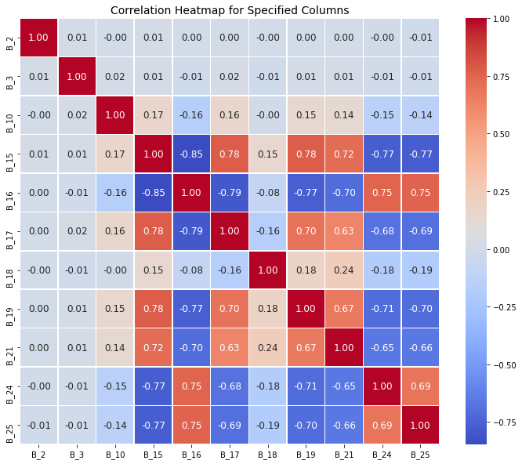
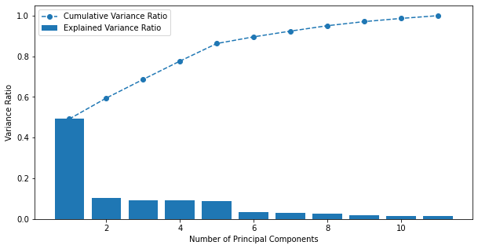
Visualisations

Slide 4
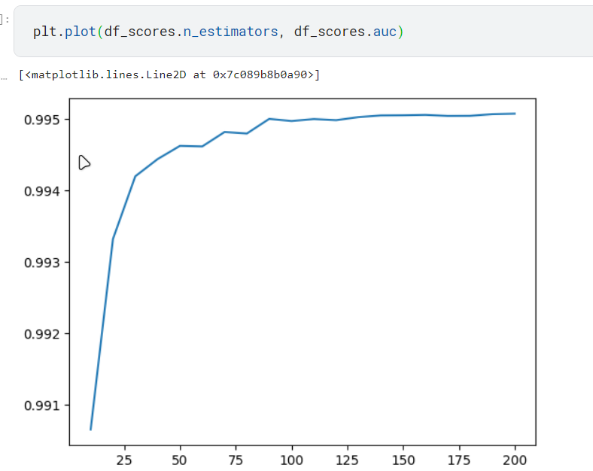
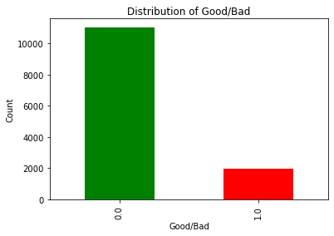

Slide 5
Feature Engineering
PCA
Oversampling

Slide 6
Modeling
Random forest
PCA
XG Boost

Slide 7
Conclusion
Decision trees was giving us 92.3% accuracy with tuning.

